Slide 1
TREATMENT OF CHRONIC PAIN
25% of the population need sometimes therapy for chronic pain in their life
Musculosceletal and neuropathic pain represent 80% of all chronic pain syndromes
Cancerous pain…

Slide 2
TREATMENT OF CHRONIC PAIN
Headache
Facial pain
Nack pain
Shoulder pain
Arm pain
Back pain
Leg pain
Knee pain…
Heel pain

Slide 3
TREATMENT OF CHRONIC PAIN EXPERT is a MUST (ambulance……….clinic)
Diagnostic
Treatment
X-ray
CT
EMG
MRI,…
Minimally invasive pain diagnostic interventions
Contemporary medications
Physiotherapy
Acupuncture
Chiropraxis
Alternative therapy
Surgery
Neuromodulation
Minimally invasive pain treatment interventions

Slide 4
TREATMENT OF CHRONIC PAIN
ESSENTIAL FOR SUCCESSFUL TREATMENT OF THE PAIN IS TO IDENTIFY:
WHICH ANATOMICAL STRUCTURE IS A SOURCE OF THE PAIN (PAIN ANATOMY)
WHAT KIND OF PATHOLOGIC PROCESS IS IN THAT STRUCTURE.

Slide 5
TREATMENT OF CHRONIC PAIN
WHEN ANATOMICAL SOURCES AND PATHOLOGICAL PROCCESS ARE IDENTIFIED SUCCESS IN PAIN TREATMENT (HEALING OR SIGNIFICANT REDUCE) IS IN 70-90% OF THE PATIENTS*
*THESE PATIENTS HAVE BEEN SUFFERING FROM PAIN FOR A LONG TIME WITHOUT THERAPY EFFECT.

Slide 6
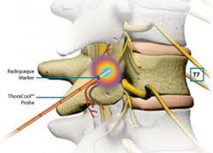
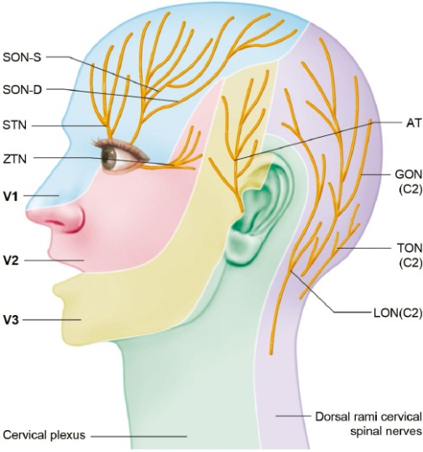
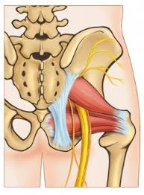
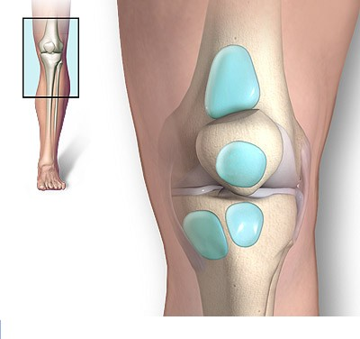
TREATMENT OF CHRONIC PAIN
PAIN ANATOMY
Every region of the body can have 10-20 possible sourrces of pain such as:
Muscle
Nerv
Ligament
Joint
Tendon
Fascia
Bursa
...

Slide 7
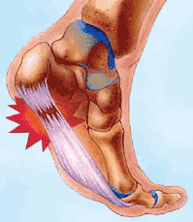
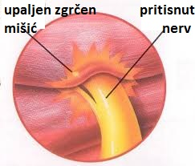
TREATMENT OF CHRONIC PAIN
Pathologic proccess in or arround these structures can be:
Inflammation
Pressure
Strein
Overstrech
Spasm
Neuropathy
...

Slide 8
TREATMENT OF CHRONIC PAIN

Slide 9
TREATMENT OF CHRONIC PAIN

Slide 10
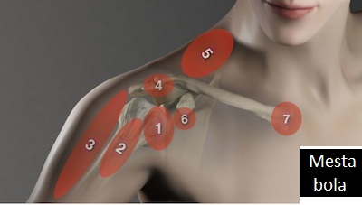
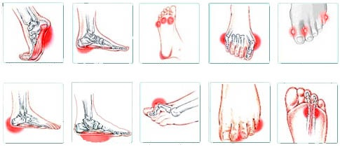
TREATMENT OF CHRONIC PAIN

Slide 11
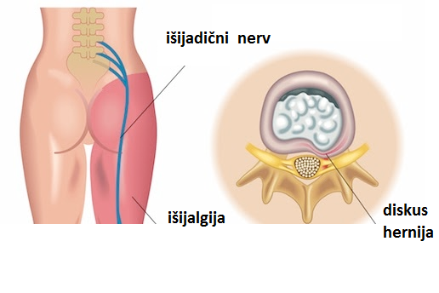
TREATMENT OF CHRONIC PAIN
Example: sciatica can be caused by discus hernia, but also by numerous other reasons

Slide 12
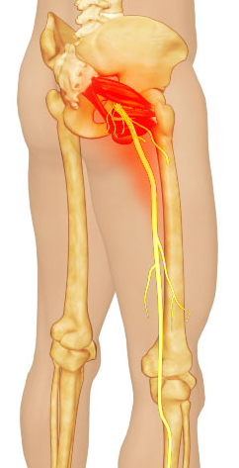
TREATMENT OF CHRONIC PAIN
The same sciatica can be caused by inflammation and spasm of some muscles causing irritation of sciatic nerve.
The problem is when nothing is evident on spine CT or MRI.
Even bigger problem could be if asimptomatic discus hernia is visible on images.

Slide 13
TREATMENT OF CHRONIC PAIN
Diagnoses which are not accurate enough:
Sciatica
Cervical syndrome
Lumbar degenerative pain
Spondilopathy
Gonarthrosis
Rheumatic disease
Headache

Slide 14
TREATMENT OF CHRONIC PAIN
OFTEN NOT DIRECT CAUSES OF PAIN:
OLD AGE
OBESITY
BAD POSTURE
DEGENERATIVE CHANGES
PSICHOLOGICAL OVERREACTION
CIRCLE CELL ANEMIA,
…

Slide 15
TREATMENT OF CHRONIC PAIN
TO DETERMINE WHICH ANATOMICAL STRUCTURE IS THE CAUSE OF PAIN ESSENTIAL IS LONG CONVERSATION WITH PATIENT COVERING ALL IMPORTANT DETAILS

Slide 16
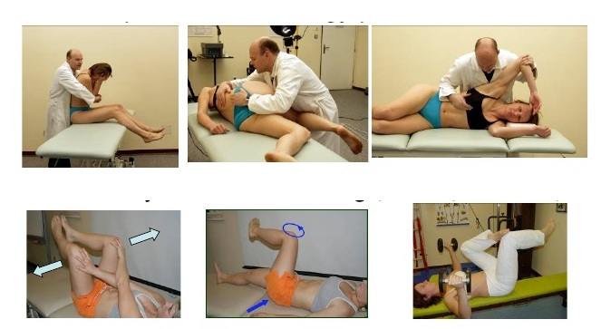
TREATMENT OF CHRONIC PAIN
SPECIFIC EXAMS–
THERE ARE GREAT NUMBER OF SPECIFIC TESTS FOR DIFFERENT ANATOMICAL STRUCTURES

Slide 17
TREATMENT OF CHRONIC PAIN EXPERT (ambulance……….clinic)
Diagnostic
Treatment
X-ray
CT
EMG
MRI,…
Minimally invasive pain diagnostic interventions
Contemporary medications
Physiotherapy
Acupuncture
Chiropraxis
Alternative therapy
Surgery
Neuromodulation
Minimally invasive pain treatment interventions

Slide 18
TREATMENT OF CHRONIC PAIN
MIN. INVASIVE PAIN INTERVENTIONS CAN PROVIDE:
MORE PRECISE DIAGNOSIS (ELIMINATING OR PROVOKING SUSPICIOUS SOURCES OF THE PAIN)
MORE PRECISE TREATMENT OF PAIN (INFILTRATION WITH POWERFUL MEDICATION, STIMULATION, DECOMPRESSION, DENERVATION,...)

Slide 19
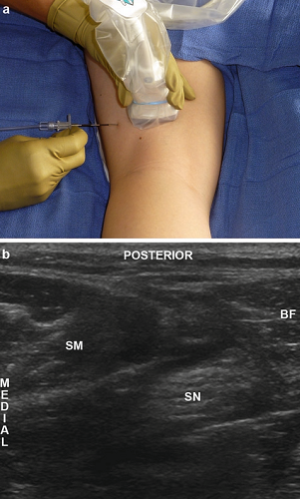
TREATMENT OF CHRONIC PAIN
MIN. INVASIVE PAIN INTERVENTIONS:
Are not classical blockades
They are performed with navigation of
ultrasound or X-ray fluorography
Navigation provides accurate application of medications
Most of them could be done ambulatory in local anesthesia
Resuts are evident immediately
Mostly 1 to 3 interventions are sufficiant
Good result can be achieved in 70-90% of all patients
They should be performed before most pain surgery procedures to avoid them if possible (e.g. spine disc surgery)

Slide 20
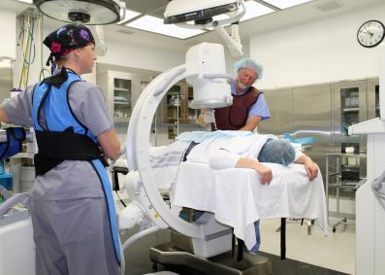
TREATMENT OF CHRONIC PAIN
PAIN INVASIVE INTERVENTION navigated by x-ray

Slide 21
TREATMENT OF CHRONIC PAIN
Spine PAIN INVASIVE INTERVENTION navigated by x-ray

Slide 22
TREATMENT OF CHRONIC PAIN
PAIN INVASIVE INTERVENTION navigated by ultrasound

Slide 23
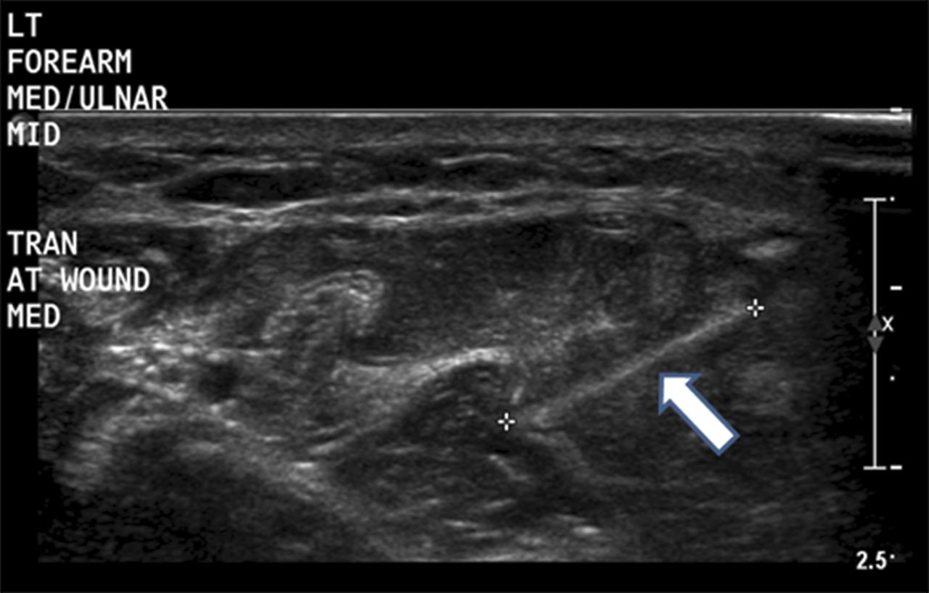
TREATMENT OF CHRONIC PAIN
PAIN INVASIVE INTERVENTION navigated by ultrasound

Slide 24
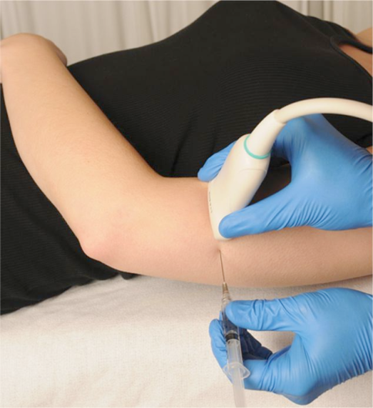
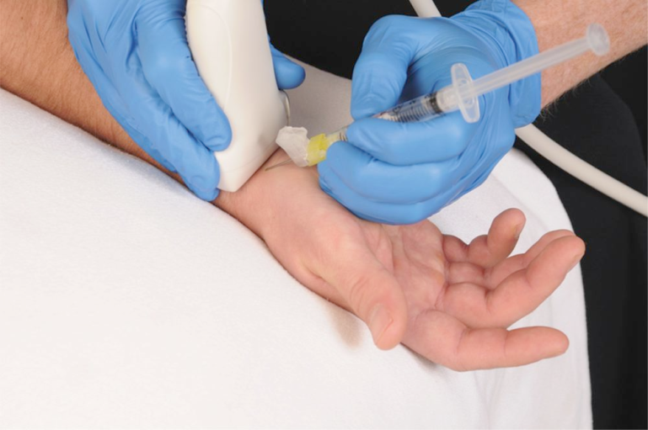
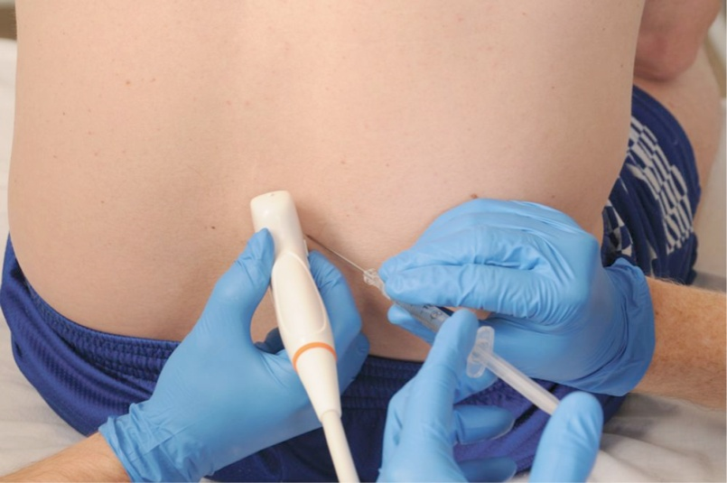
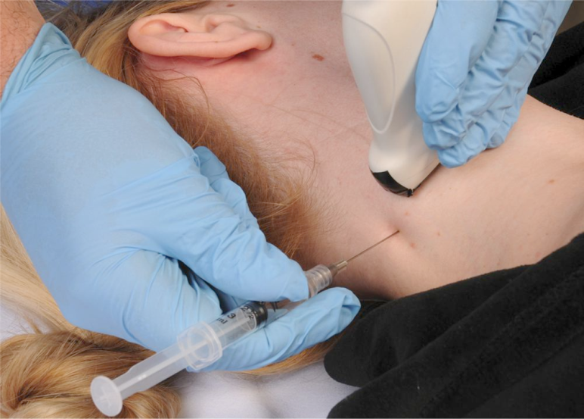
TREATMENT OF CHRONIC PAIN
PAIN INVASIVE INTERVENTIONS navigated by ultrasound

Slide 25
TREATMENT OF CHRONIC PAIN
CONCLUSION
Essential for successful treatment of persistent pain is to identify it’s real source (PAIN ANATOMY KNOWLEDGE)
This can be done after detailed conversation with the patients, specific examinations and invasive diagnostic pain procedures
When classical pain therapy doesn’t help invasive therapeutic pain procedures should be applied
For the success 1-3(-5,…) procedures are usually needed
Success rate is in 70-90% of patients suffering from chronic pain resistent to other therapies

Slide 26
TREATMENT OF CHRONIC PAIN
In Hospital La Paz Malabo there are
Medications allready provided or can be provided
Experts with knowledge of PAIN ANATOMY and contemporary medication treatment, physiotherapy, acupuncture, invasive procedures and surgeries for pain treatment
Essential equipement
Rooms, offices and ambulances can be organised for this purpose
Hotel capasities for foreign ambulatory patients in the form of health tourism
When necessary patinets’ beds and surgical equipment for minimally invasive surgeries can be obtained
Academic requirements for starting education for medical students, doctors and nurses
Internet and SEO abilities to promote our potentials

